Slide 1

8th Grade Math: Pre-Algebra
Unit 8, Lesson 8 Solutions to Systems of Equations Volume 2, pg. 38

Slide 2


Benchmarks
MA.8.AR.4.1
Given a system of two linear equations and specified set of possible solutions, determine which ordered pairs satisfy the system of linear equations.
MA.8.AR.4.2
Given a system of two linear equations represented graphically on the same coordinate plane, determine whether there is one solution, no solution, or infinitely many solutions.
volume 2, pg. 38

Slide 3
Integrated Mathematical Thinking and Reasoning Standards
MA.K12.MTR.2.1 Demonstrate understanding by representing problems in multiple ways.
MA.K12.MTR.4.1 Engage in discussions that reflect on the mathematical thinking of self and others.
MA.K12.MTR.5.1 Use patterns and structure to help understand and connect mathematical concepts.
volume 2, pg. 38

Slide 4

Learning Targets
I can determine algebraically if an ordered pair satisfies the given system of linear equations.
I can verify graphically when a system of linear equations has one solution, no solution, or infinitely many solutions.
volume 2, pg. 38

Slide 5

Warm-Up
volume 2, pg. 39

Slide 6
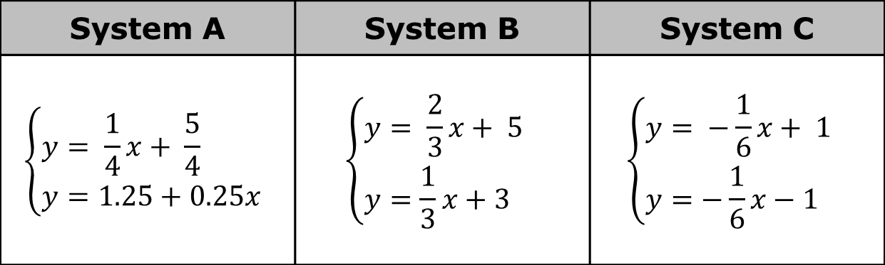
8.8.1 Warm-Up: Bell Work
Three systems of equations are shown.
System A | System B | System C
$$\left\{\begin{aligned}&y= \frac{1}{4}x+ \frac{5}{4} \\ &y=1.25+0.25x\end{aligned}\right.$$ | $$\left\{\begin{aligned}&y= \frac{2}{3}x+ 5 \\ &y=\frac{1}{3}x+3\end{aligned}\right.$$ | $$\left\{\begin{aligned}&y= −\frac{1}{6}x+ 1 \\ &y=−\frac{1}{6}x−1\end{aligned}\right.$$
volume 2, pg. 39

Slide 7
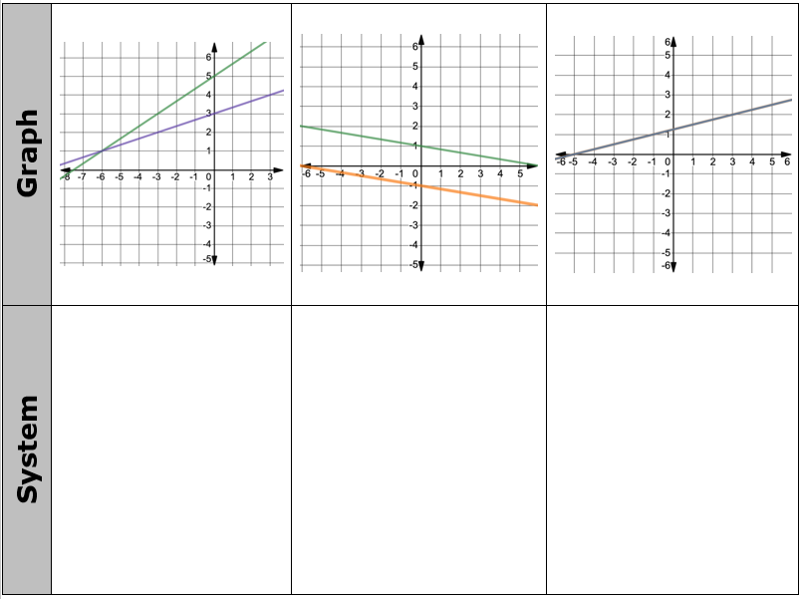
The graphs of each system are shown. Match each system of linear equations with its graphical representation.
volume 2, pg. 39

Slide 8

Guided Instruction
volume 2, pg. 39

Slide 9
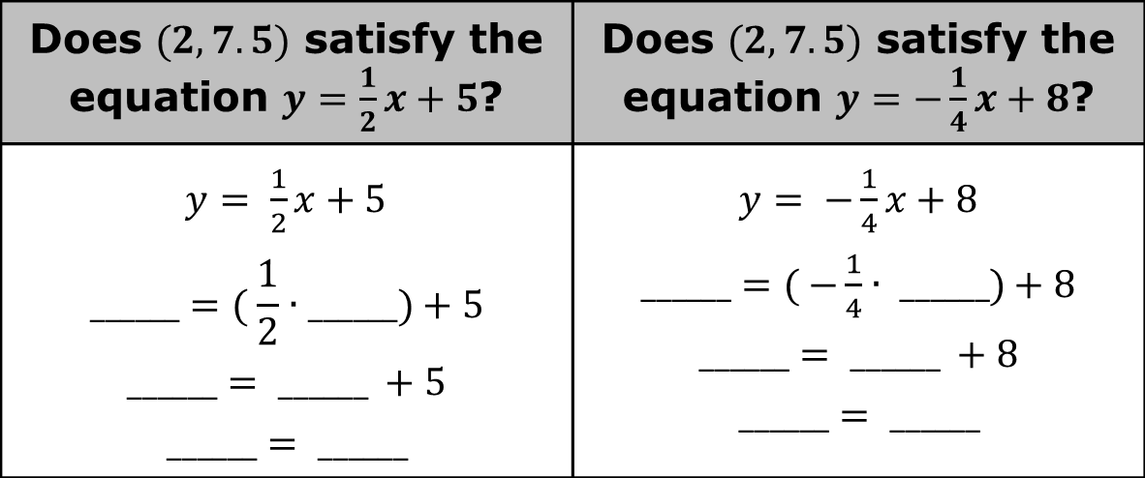
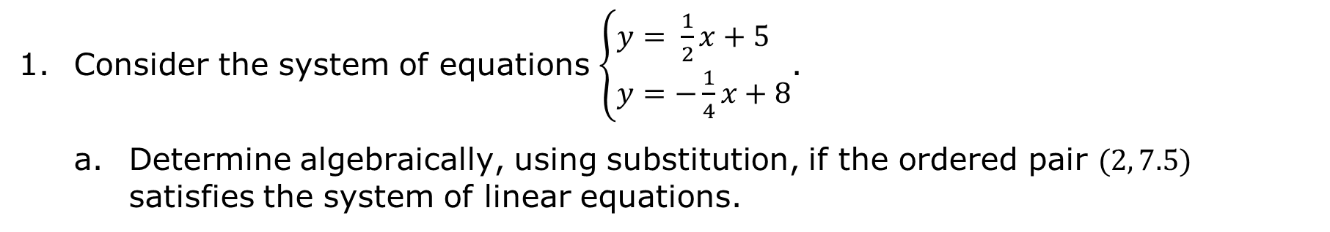
8.8.2 Guided Instruction: Solutions to Systems of Equations
Consider the system of equations $\left\{\begin{aligned}&y= \frac{1}{2}x+5 \\ &y=−\frac{1}{4}x+8\end{aligned}\right.$.
Determine algebraically, using substitution, if the ordered pair $(2, 7.5)$ satisfies the system of linear equations.
Does $(2,7.5)$ satisfy the equation $y=\frac{1}{2}x+5$? | Does $(2,7.5)$ satisfy the equation $y=−\frac{1}{4}x+8$?
$y= \frac{1}{2}x+5$ $$______=( \frac{1}{2}∙______)+5$$ $$______= ______ +5$$ $$______= ______$$ | $y= −\frac{1}{4}x+8$ $______=( −\frac{1}{4}∙ ______)+8$ $$______= ______ +8$$ $$______= ______$$
volume 2, pg. 39

Slide 10

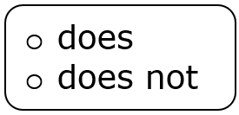
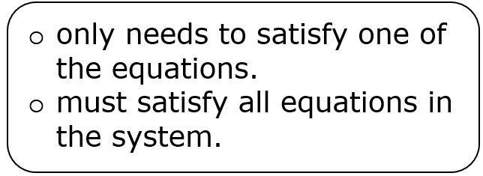
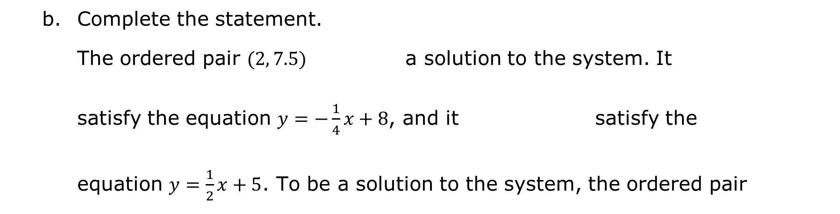
Complete the statement.
The ordered pair $(2, 7.5)$ a solution to the system. It satisfy the equation $y=−\frac{1}{4}x+8$, and it satisfy the equation $y=\frac{1}{2}x+5$. To be a solution to the system, the ordered pair
volume 2, pg. 39

Slide 11
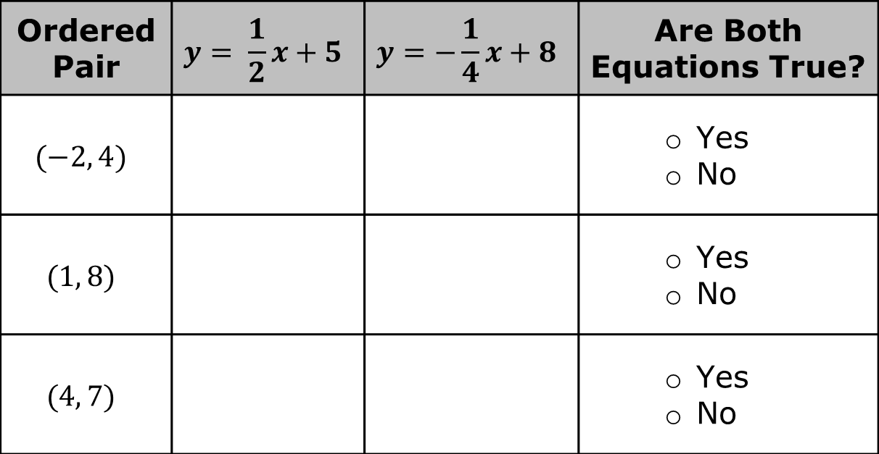

Complete the table to determine if each ordered pair satisfies both equations in the system.
What is the solution to the system $\left\{\begin{aligned}&y= \frac{1}{2}x+5 \\ &y=−\frac{1}{4}x+8\end{aligned}\right.$?
Ordered Pair | $$y= \frac{1}{2}x+5$$ | $$y=−\frac{1}{4}x+8$$ | Are Both Equations True?
$$(−2, 4)$$ |  |  | Yes No
$$(1, 8)$$ |  |  | Yes No
$$(4, 7)$$ |  |  | Yes No
volume 2, pg. 40

Slide 12
The graph of $y= \frac{1}{2}x+5$ is shown on the coordinate grid.
volume 2, pg. 40

Slide 13
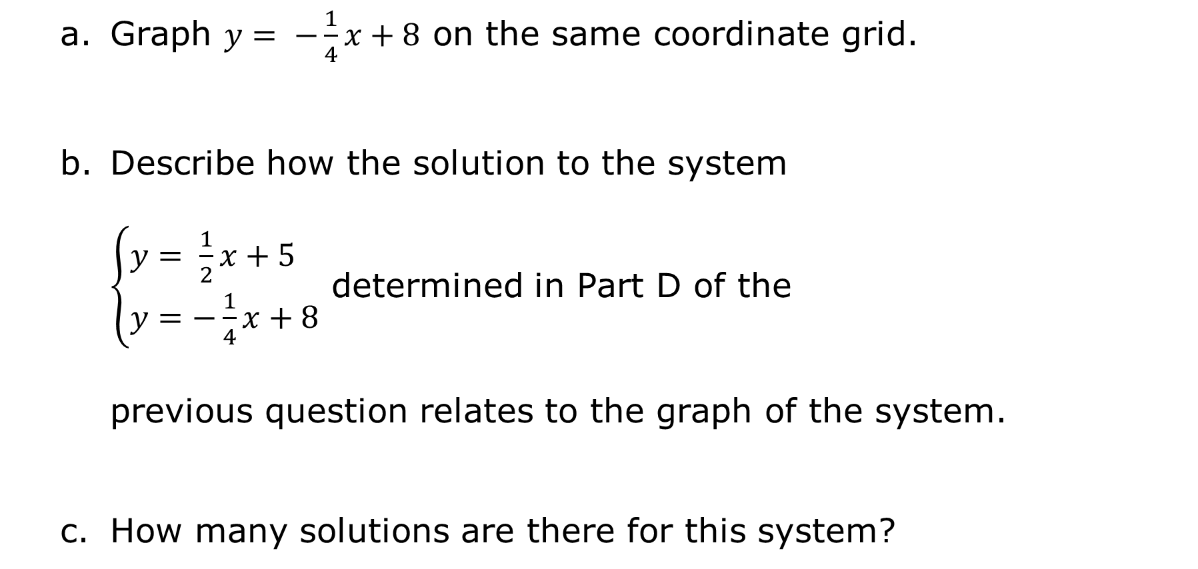
Graph $y= −\frac{1}{4}x+8$ on the same coordinate grid.
Describe how the solution to the system $\left\{\begin{aligned}&y= \frac{1}{2}x+5 \\ &y=−\frac{1}{4}x+8\end{aligned}\right.$ determined in Part D of the previous question relates to the graph of the system.
How many solutions are there for this system?
volume 2, pg. 40

Slide 14
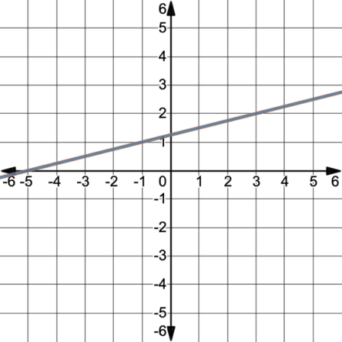
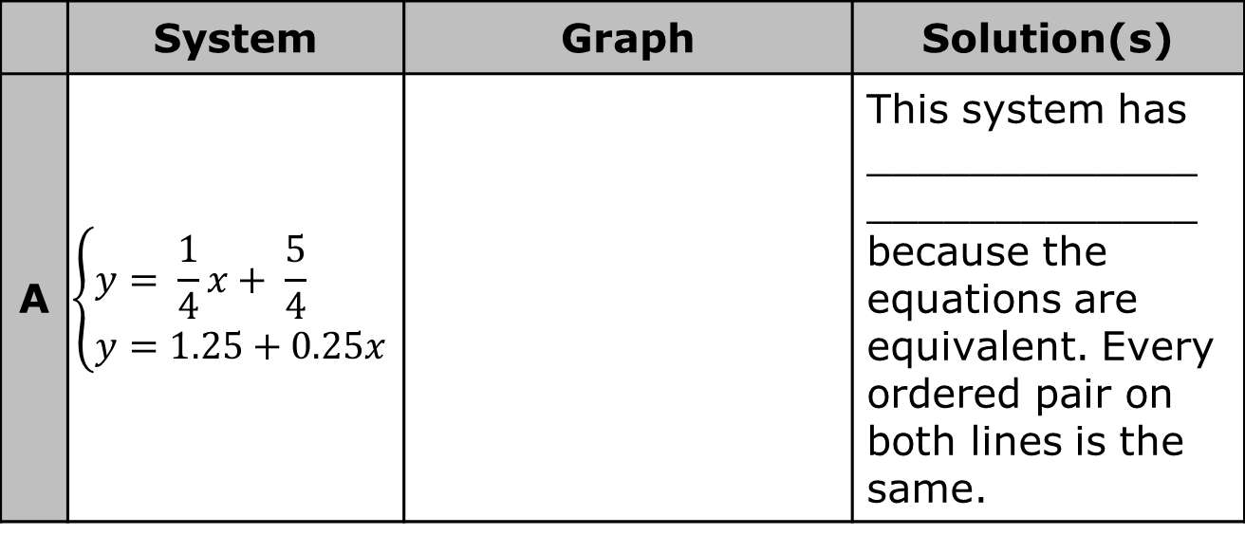
Systems of equations in two variables can have one solution, no solution, or infinitely many solutions.
The systems of equations and their corresponding graphs from the Warm-Up are shown again in the table.
Complete the description of the solution(s) for each system using the phrase one solution, no solution, or infinitely many solutions.
 | System | Graph | Solution(s)
A | $$\left\{\begin{aligned}&y= \frac{1}{4}x+ \frac{5}{4} \\ &y=1.25+0.25x\end{aligned}\right.$$ |  | This system has _____________ _____________ because the equations are equivalent. Every ordered pair on both lines is the same.
volume 2, pg. 41

Slide 15
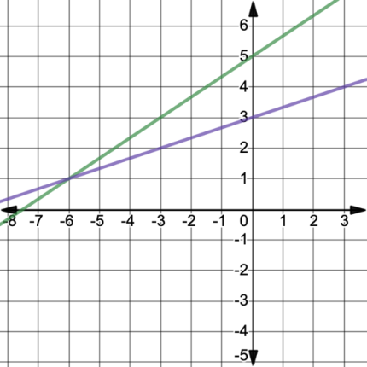
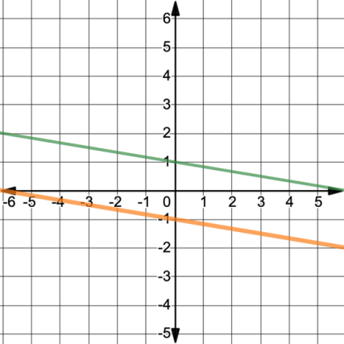
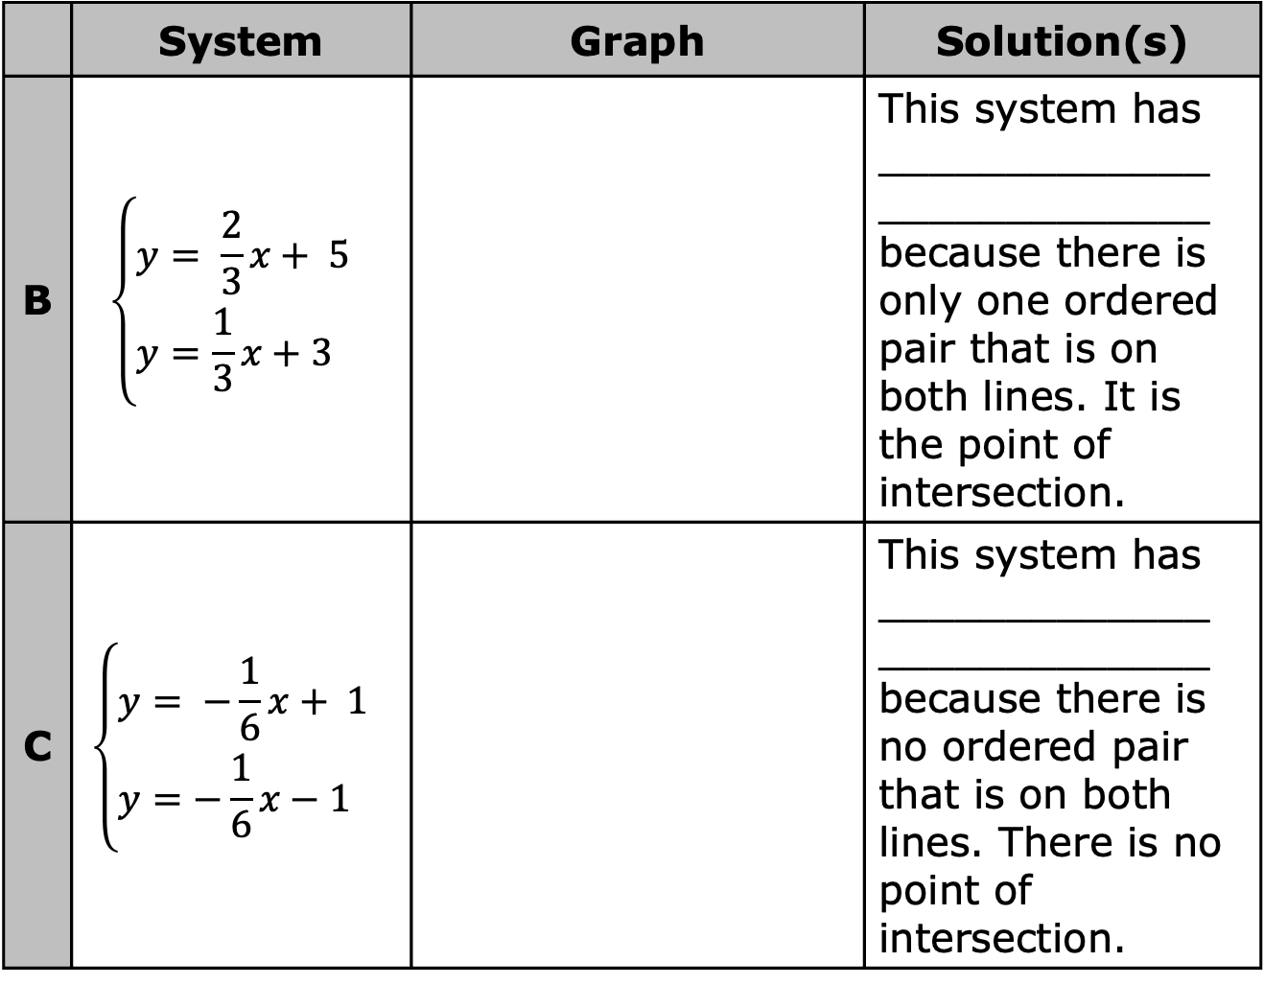
 | System | Graph | Solution(s)
B | $$\left\{\begin{aligned}&y= \frac{2}{3}x+ 5 \\ &y=\frac{1}{3}x+3\end{aligned}\right.$$ |  | This system has _____________ _____________ because there is only one ordered pair that is on both lines. It is the point of intersection.
C | $$\left\{\begin{aligned}&y= −\frac{1}{6}x+ 1 \\ &y=−\frac{1}{6}x−1\end{aligned}\right.$$ |  | This system has _____________ _____________ because there is no ordered pair that is on both lines. There is no point of intersection.
volume 2, pg. 41

Slide 16
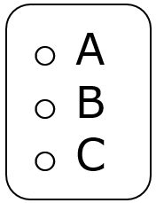
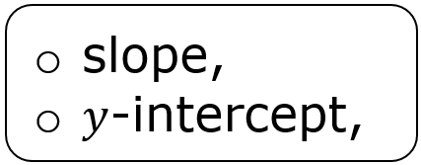
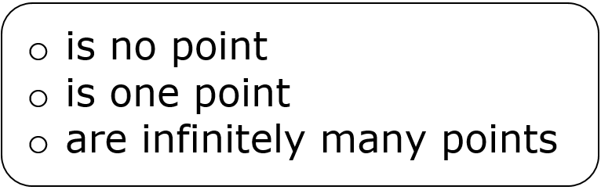
Complete the statements.
System has no solution because the lines in this system are parallel. Parallel lines have the same so there
where the lines will intersect.
volume 2, pg. 41

Slide 17

Guided Practice
volume 2, pg. 42

Slide 18

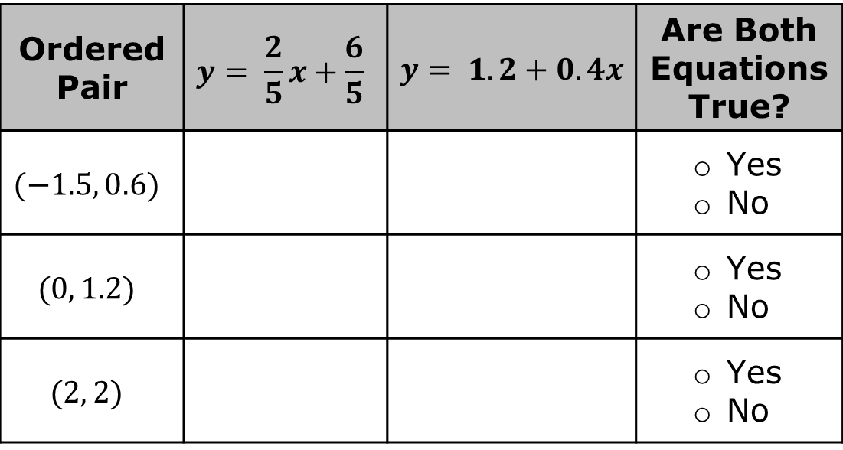
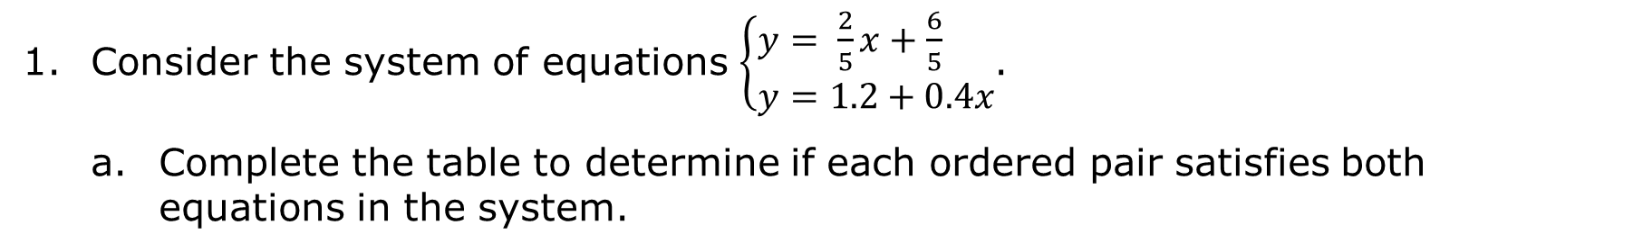
8.8.3 Guided Practice: Solutions to Systems of Equations
Consider the system of equations $\left\{\begin{aligned}&y= \frac{2}{5}x+\frac{6}{5} \\ &y=1.2+0.4x\end{aligned}\right.$.
Complete the table to determine if each ordered pair satisfies both equations in the system.
Ordered Pair | $$y= \frac{2}{5}x+\frac{6}{5}$$ | $y= 1.2+0.4x$ | Are Both Equations True?
$$(−1.5, 0.6)$$ |  |  | Yes No
$$(0, 1.2)$$ |  |  | Yes No
$$(2, 2)$$ |  |  | Yes No
volume 2, pg. 42

Slide 19
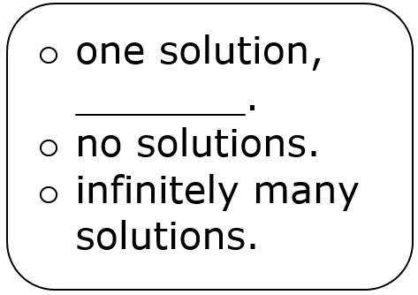
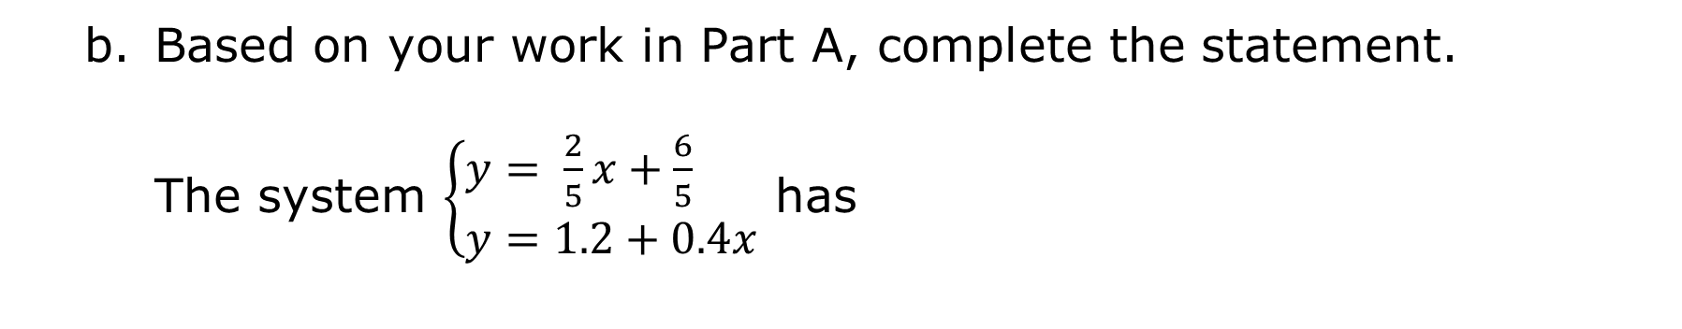
Based on your work in Part A, complete the statement.
The system $\left\{\begin{aligned}&y= \frac{2}{5}x+\frac{6}{5} \\ &y=1.2+0.4x\end{aligned}\right.$ has
volume 2, pg. 42

Slide 20
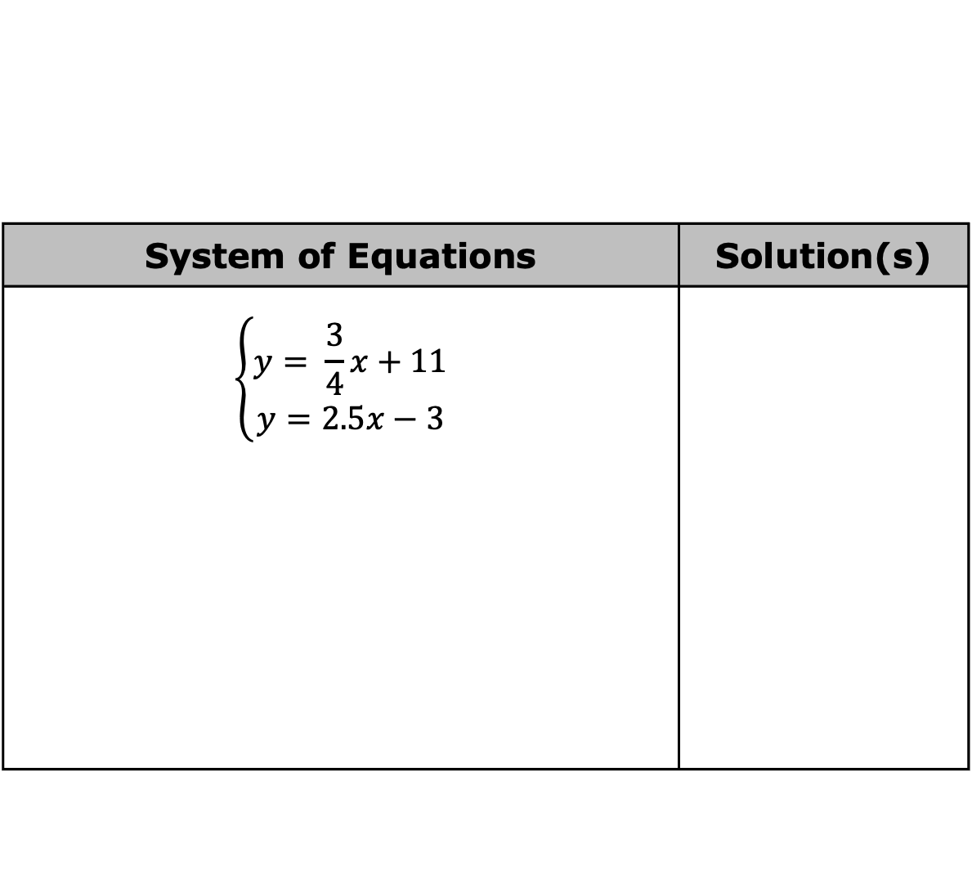
For each system of equations, determine whether there is one solution, no solution, or infinitely many solutions. If there is only one solution, give the solution.
System of Equations | Solution(s)
$$\left\{\begin{aligned}y= \frac{3}{4}x+11 \\ y=2.5x−3\end{aligned}\right.$$
volume 2, pg. 42

Slide 21
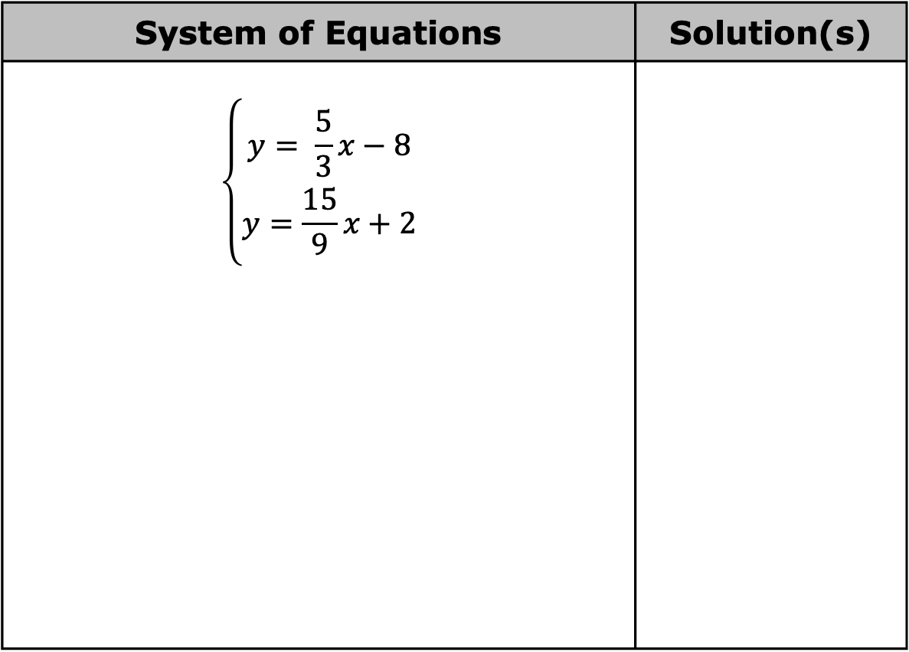
System of Equations | Solution(s)
$$\left\{\begin{aligned}y= \frac{5}{3}x−8 \\ y=\frac{15}{9}x+2\end{aligned}\right.$$
volume 2, pg. 42

Slide 22

Your Turn
volume 2, pg. 43

Slide 23
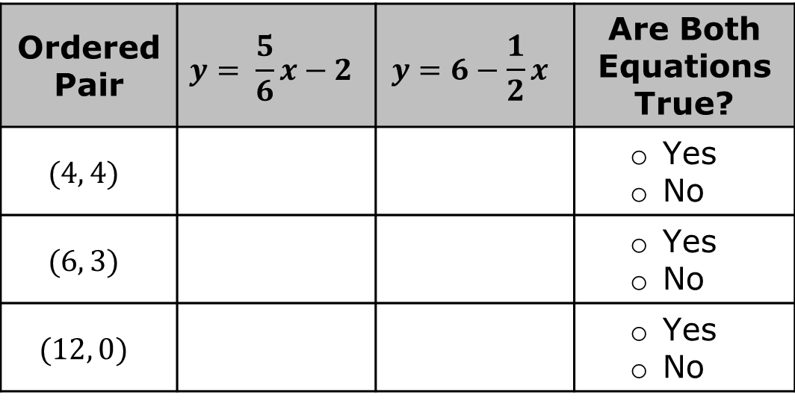
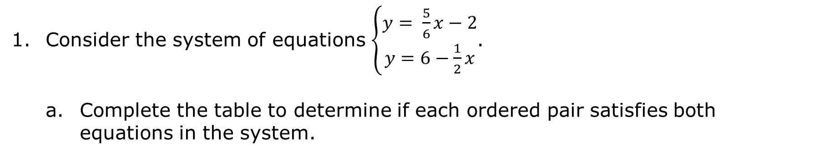
8.8.4 Your Turn!
Consider the system of equations $\left\{\begin{aligned}y= \frac{5}{6}x−2 \\ y=6−\frac{1}{2}x\end{aligned}\right.$.
Complete the table to determine if each ordered pair satisfies both equations in the system.
Ordered Pair | $$y= \frac{5}{6}x−2$$ | $$y=6−\frac{1}{2}x$$ | Are Both Equations True?
$$(4, 4)$$ |  |  | Yes No
$$(6, 3)$$ |  |  | Yes No
$$(12, 0)$$ |  |  | Yes No
volume 2, pg. 43

Slide 24
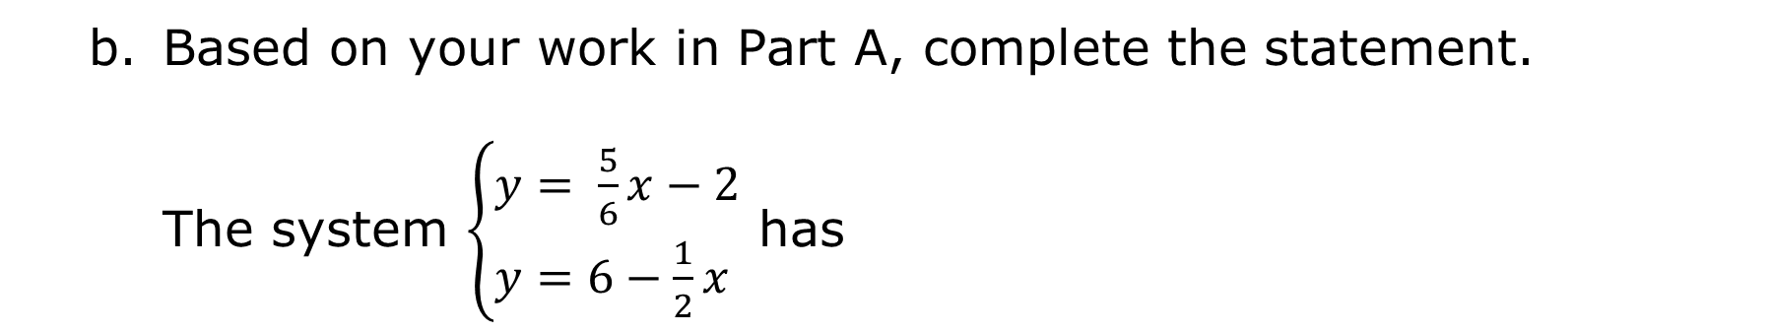
Based on your work in Part A, complete the statement.
The system $\left\{\begin{aligned}&y= \frac{5}{6}x−2 \\ &y=6−\frac{1}{2}x\end{aligned}\right.$ has
volume 2, pg. 43

Slide 25

The graph of the system $\left\{\begin{aligned}&y= \frac{5}{6}x−2 \\ &y=6−\frac{1}{2}x\end{aligned}\right.$ is shown.
Use the graph to explain why your answer to Part B is correct.
volume 2, pg. 43

Slide 26

Wrap-Up
volume 2, pg. 44

Slide 27

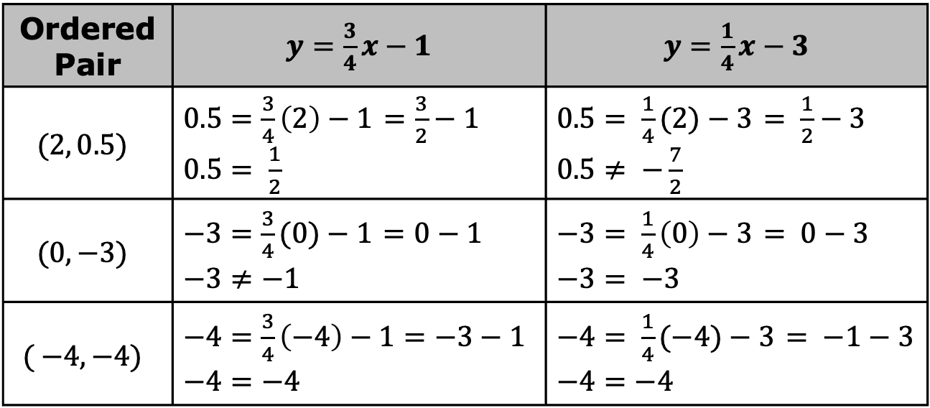
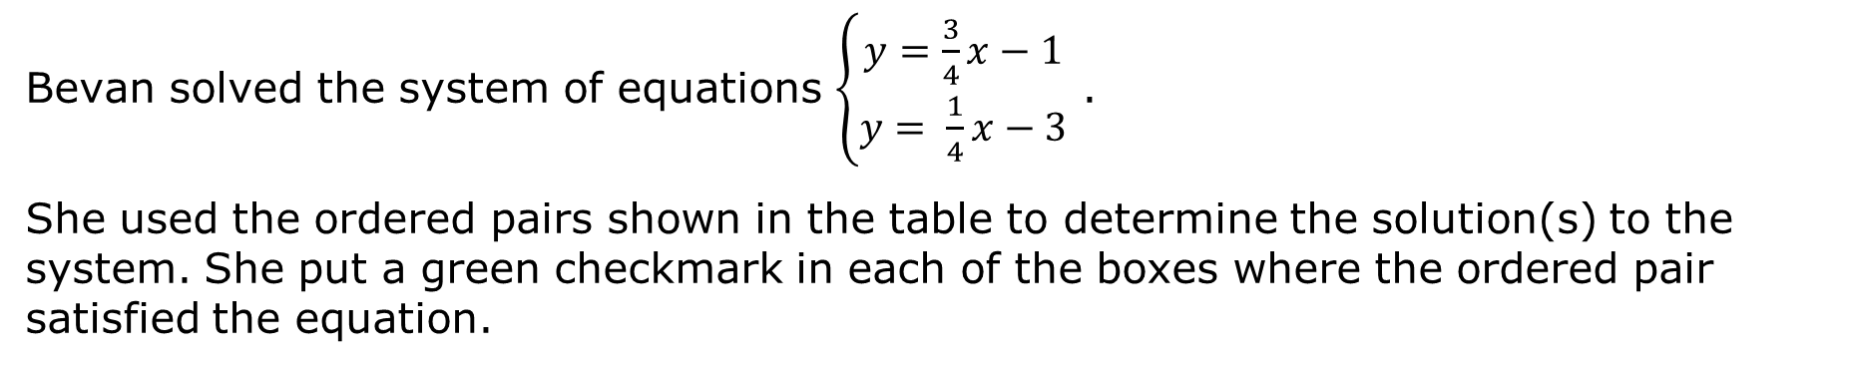
8.8.5 Wrap-Up: Error Analysis
Bevan solved the system of equations $\left\{\begin{aligned}y=\frac{3}{4}x−1 \\ y= \frac{1}{4}x−3\end{aligned}\right.$ .
She used the ordered pairs shown in the table to determine the solution(s) to the system. She put a green checkmark in each of the boxes where the ordered pair satisfied the equation.
Ordered Pair | $y=\frac{3}{4}x−1$ | $y=\frac{1}{4}x−3$
$$(2, 0.5)$$ | $0.5=\frac{3}{4}\left(2\right)−1$ $=\frac{3}{2}−1$ $0.5= \frac{1}{2}$ | $0.5= \frac{1}{4}(2)−3$ $= \frac{1}{2}−3$ $0.5≠ −\frac{7}{2}$
$$(0, −3)$$ | $−3=\frac{3}{4}(0)−1$ $=0−1$ $$−3≠−1$$ | $−3= \frac{1}{4}\left(0\right)−3$ $= 0−3$ $−3= −3$
$$( −4, −4)$$ | $−4=\frac{3}{4}\left(−4\right)−1=−3−1$ $$−4=−4$$ | $−4= \frac{1}{4}(−4)−3$ $= −1−3$ $$−4=−4$$
volume 2, pg. 44

Slide 28
She concluded there are infinitely many solutions to the system because more than one point satisfies the equations.
Write a short note to Bevan explaining the error she made.
volume 2, pg. 44

